Slide 1


CAPSTONE PROJECT
Code, Coffee, and Chaos: Developer Productivity Analysis
Presented By
Student Name: Kshitij Milind gaikwad
College Name: b. k. birla college kalyan
Department: b. sc. Data science
Email ID: ksgaik1610@gmail.com

Slide 2
OUTLINE:
Problem Statement
Proposed System/Solution
System Development Approach
Algorithm & Deployment
Result (Output Image)
Conclusion
Future Scope
References

Slide 3
Problem Statement:
Software development environments often generate massive datasets regarding work habits and output.
It is difficult for managers to manually identify the specific drivers of productivity among work duration and caffeine intake.
The challenge is to determine if developer output is truly "chaotic" or if it follows predictable, scalable patterns.

Slide 4
Proposed Solution:
Developed an interactive Power BI Dashboard to visualize the correlation between Coding Hours, Coffee Consumption, and Bugs Fixed.
Data Source: Analyzed a dataset consisting of 25,000 developer records.
Calculated Metrics: Engineered an "Efficiency" metric (Bugs per Hour) to standardize performance across the workforce.

Slide 5
System Approach:
Technologies Used:
Power BI Desktop: For dashboard creation and visual reporting.
Power Query: For data cleaning, transformation, and binning of efficiency metrics.
DAX: Utilize d for calculating KPIs such as Average Efficiency, Average Coding Hours, and Average Coffee Cups.
Design Strategy: Applied a high-contrast dark theme to optimize the "data-to-ink" ratio for better clarity

Slide 6
Algorithm & Deployment:
Data Input: Importation of the 25,000-record dataset into the Power BI environment.
Transformation: Created bins for efficiency to generate a statistical distribution (Normal Distribution/Bell Curve).
Analysis: Conducted correlation analysis, identifying a 0.98 coefficient between coding hours and output.
Deployment: Published an interactive dashboard featuring KPI cards, scatter plots, and heatmaps

Slide 7
Result:
Core KPIs:
Average Efficiency: 5.16 Bugs Fixed per Hour.
Average Work Session: 6.47 Hours.
Average Caffeine Intake: 3.75 Cups.
Key Findings:
Productivity Engine: A near-perfect linear relationship exists between effort and output; output scales predictably with time.
Caffeine Catalyst: Coffee consumption shows a 0.90 correlation with resolution rates, acting as a primary statistical driver.
Standardization: Most developers fall within the 4–6 bugs per hour range, indicating stable team efficiency.

Slide 8
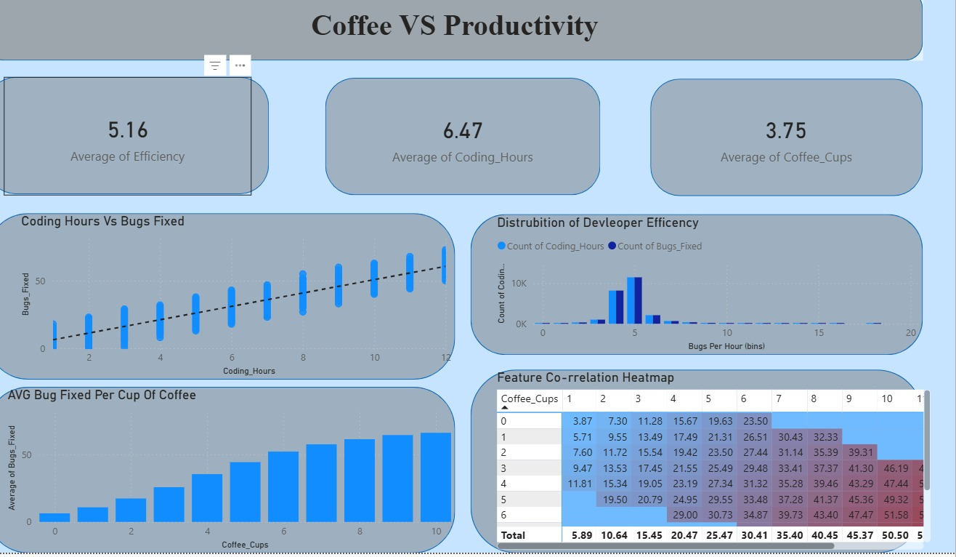
Result:

Slide 9
Conclusion:
The visual analysis proves that developer output is highly predictable rather than chaotic.
While time spent coding is the absolute primary driver of results, caffeine serves as a powerful secondary catalyst for sustaining performance.
The dashboard successfully converts raw work-habit data into actionable management insights.

Slide 10
Future scope:
Predictive Analytics: Integrate Machine Learning to forecast future bug resolution based on historical work patterns.
Real-Time Data: Connect the dashboard to live Jira or GitHub repositories for real-time productivity tracking.
Cloud Deployment: Publish the system to Power BI Service for mobile access by team leads and managers.

Slide 11
References:
Kaggle Dataset: "Code, Coffee, and Chaos" – Primary source for the 25,000 developer work habit records.
Microsoft Power BI Documentation: Used for implementing Data Analysis Expressions (DAX) and Power Query transformations.
Github: 🔗Link

Slide 12
Thank You

